Slide 1
MongoDB Research
Group 6
Jiongfeng Chen
Yuanyuan Jia
Xiaotong Wang
Xing Yang
Xingxing Ju

Slide 2
Outline
Brief Introduction
Replication Architecture
Comparison with Other NoSQL DBs
Query Language Demo
Optimal Usage Demo
CP Scenario Demo

Slide 3
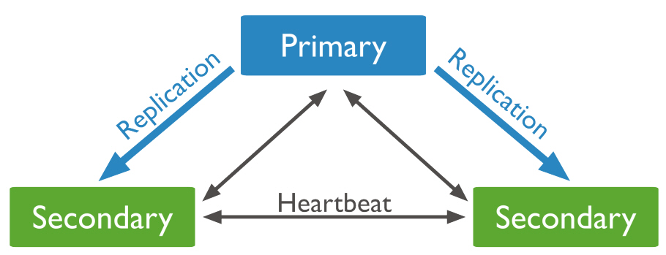
Replication Architecture
Replica set: a group of instances that maintain the same data set.
data bearing nodes, arbiter node, hidden node(support dedicated workloads).
only one member is deemed the primary node, the other data bearing nodes are deemed secondary nodes
fault tolerance

Slide 4
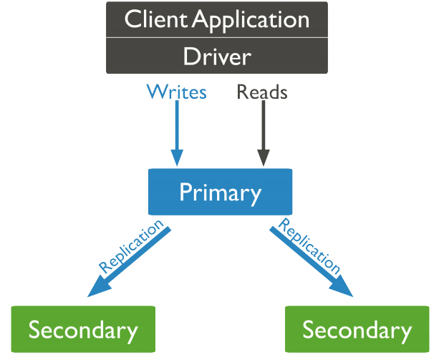
Read/Write
By default, an application directs its read operations to the primary member in a replica set.
The primary node receives all write operations. the primary records all changes to its data sets in its operation log.
The primary’s oplog is replicated and apply the operations to data sets such that the secondaries’ data sets reﬂect the primary’s data set.

Slide 5
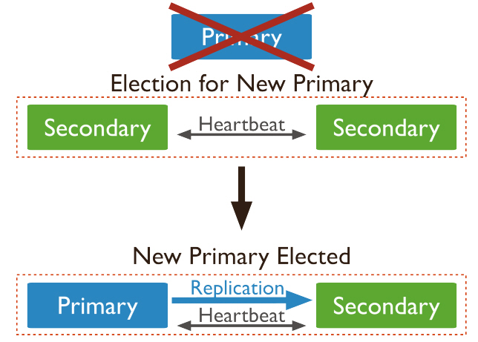
Automatic Failover
The primary is unavailable, an eligible secondary will hold an election to elect itself the new primary. (10 seconds)
An eligible secondary will hold an election to elect itself the new primary. The ﬁrst secondary to hold an election and receive a majority of the members’ votes becomes primary.

Slide 6
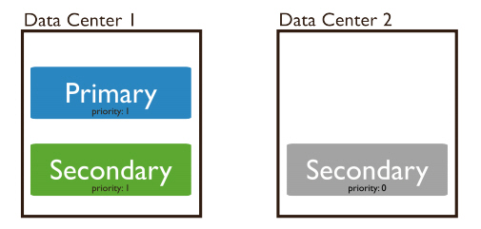
Priority 0
A priority 0 member is a secondary that cannot become primary. Cannot trigger elections. Otherwise, function as normal secondaries. A priority 0 member maintains a copy of the data set, accepts read operations, and votes in elections.
Conﬁgure a priority 0 member to prevent secondaries from becoming primary, which is particularly useful in multi-data center deployments.

Slide 7
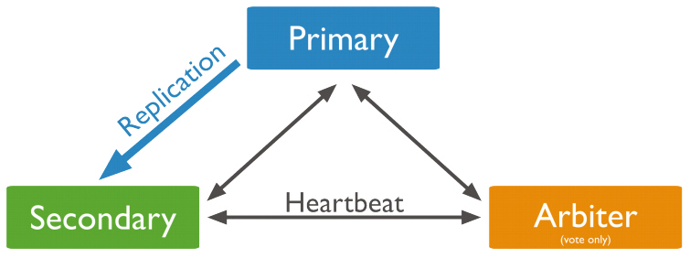
Election
Occur after initiating a replica set
Any time the primary becomes unavailable
When majority of the replica set is inaccessible or unavailable to the current primary, the primary will step down and become a secondary

Slide 8
Master Slave Replication
Master-slave replication first developed in early version of MongoDB.
Master-slave replication preceded replica sets and made it possible to have a large number of non-master nodes, as well as to restrict replicated operations to only a single database; however, master-slave does not automate failover.
In addition to providing all the functionality of master-slave deployments, replica sets are also more robust for production use.

